Slide 1
Presentation on Stock Price Prediction Using LSTM Networks By Rohit Chauhan –TY B- 22210640-312009 Venkatesh Deshmukh–TY B-22210543- 312011 Praveen Funde–TY B- 22210088- 312014 Tanish Jain –TY B- 22211492- 312021 Subject : Machine Learning
Guided by
Yogesh Dandawate
Department of Electronics and Telecommunications
Vishwakarma Institute of Information Technology,Pune

Slide 2
Outline
Introduction
Motivation
Literature Survey
Objectives
Methodology
Dataset
Implementation
Different Phases of Implementation
Results
Conclusions
References

Slide 3

Introduction
Objective:
To predict future stock prices using Deep Learning techniques, particularly Long Short-Term Memory (LSTM) networks.
Key Components:
Data Source: Historical stock price data from Yahoo Finance API.
Model Used: LSTM for time series prediction.
Evaluation Metrics: Mean Squared Error (MSE), Root Mean Squared Error (RMSE), and R-Squared (R2) to measure prediction accuracy.

Slide 4
Introduction
Features:
Data Preprocessing: Includes handling missing data, scaling, and preparing the dataset for training.
Model Architecture: 4 hidden layers of LSTM with Dropout for regularization to prevent overfitting.
Prediction Goal: Forecasting stock prices for a given day or future dates.
Outcome:
Accurately predicts stock prices, offering valuable insights for trading and investment decisions.

Slide 5
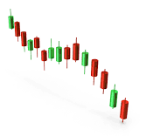
Motivation
Growing Interest in Financial Market Analysis:
The stock market plays a crucial role in the global economy and investment decisions.
Predicting stock prices can significantly impact investors, businesses, and financial markets.
Desire to Innovate: Aimed at building solutions that could improve financial decision-making using cutting-edge technology.

Slide 6
Literature Survey
Author(s) / Year | Methodology | Key Findings / Contributions | Relevance to Current Project
Mochihashi et al. (2016) | LSTM Network for Stock Prediction | LSTM models can effectively predict stock prices by learning temporal dependencies. | Provides foundation for using LSTM in financial predictions.
Fischer & Krauss (2018) | Deep Learning (LSTM & RNN) | Demonstrated that deep learning models outperform traditional methods like ARIMA for stock prediction. | Supports use of LSTM for time-series forecasting.
Krauss et al. (2017) | Machine Learning Algorithms | Applied reinforcement learning to stock price forecasting, achieving better-than-market returns. | Highlights the potential of machine learning in financial markets.
Deng et al. (2019) | Hybrid LSTM & CNN Model | Used hybrid models combining LSTM and CNN to enhance prediction accuracy in volatile markets. | Inspires hybrid approaches for improving model accuracy.
Zhang et al. (2020) | Support Vector Machines (SVM) | Compared SVM with LSTM, highlighting LSTM’s superior performance in capturing non-linear relationships. | Justifies the choice of LSTM for predicting stock market trends.
Chaudhuri et al. (2021) | ARIMA vs. LSTM | Found that LSTM significantly outperforms ARIMA for stock price prediction in terms of accuracy. | Reinforces the preference for LSTM over traditional time series models.

Slide 7
Objectives or Aim and Objectives
Aim:
To predict future stock prices using Long Short-Term Memory (LSTM) networks, leveraging historical stock data for improved decision-making in financial markets.
Objectives:
To develop and train an LSTM model capable of forecasting stock prices based on historical data.
To evaluate model performance using metrics like Mean Squared Error (MSE) and R-Squared (R²) to ensure prediction accuracy.
To explore the effectiveness of deep learning techniques for time-series prediction in financial markets.

Slide 8
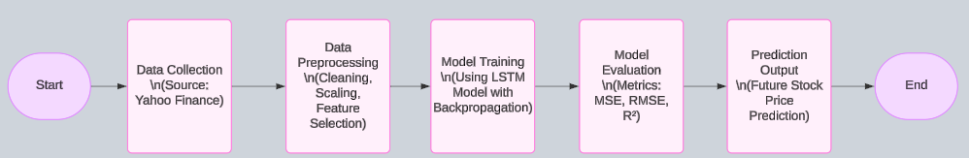
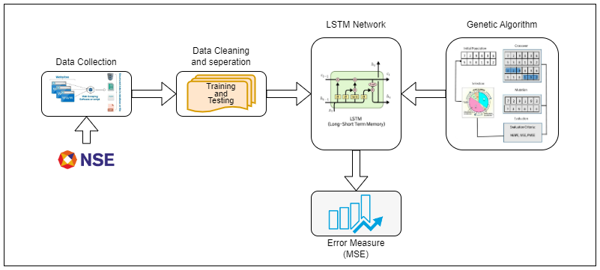
Methodology Block Diagram

Slide 9
Dataset used
Source:
The dataset is obtained from Yahoo Finance, using the yfinance library, which provides historical stock data from various global stock exchanges.
Number of Samples:
The dataset consists of daily stock price data for a specified time period with each sample representing a day's stock market information.
Features/Columns:
Date: The date of the stock record.
Open: The opening price of the stock for the day.
High: The highest price during the day.
Low: The lowest price during the day.
Close: The closing price of the stock for the day.
Volume: The number of shares traded on that day.
Adj Close: The adjusted closing price after splits and dividends.

Slide 10
Different Phases of Implementation
1) Data Collection & Preprocessing:
Data Collection: Fetch stock market data from Yahoo Finance using the yfinance library.
Data Cleaning: Handle missing values, outliers, and inconsistencies.
Feature Scaling: Normalize the data using MinMaxScaler to ensure all features are within a similar range.
Data Splitting: Split the data into training and testing datasets (e.g., 80% training, 20% testing).
2) Model Development:
LSTM Model Design:
Build a Sequential model with LSTM layers for time-series prediction.
Add Dropout layers to prevent overfitting.
3) Model Compilation: Compile the model using the Adam optimizer and Mean Squared Error (MSE) loss function.

Slide 11
Different Phases of Implementation
4) Model Training:
Train the Model: Feed the training data into the LSTM model and train it for multiple epochs (e.g., 50-100).
Hyperparameter Tuning: Adjust parameters like learning rate, number of units in LSTM layers, etc., for better performance.
5) Model Evaluation:
Performance Metrics: Evaluate the model using metrics such as MSE, RMSE, and R-squared (R²).
Testing on Unseen Data: Test the model on the test dataset to assess its generalization capability.
6) Prediction & Deployment:
Predict Stock Prices: Use the trained model to predict stock prices for future dates.
Deployment: Deploy the model in a suitable environment (e.g., web app with Streamlit or Flask) for real-time predictions.

Slide 12
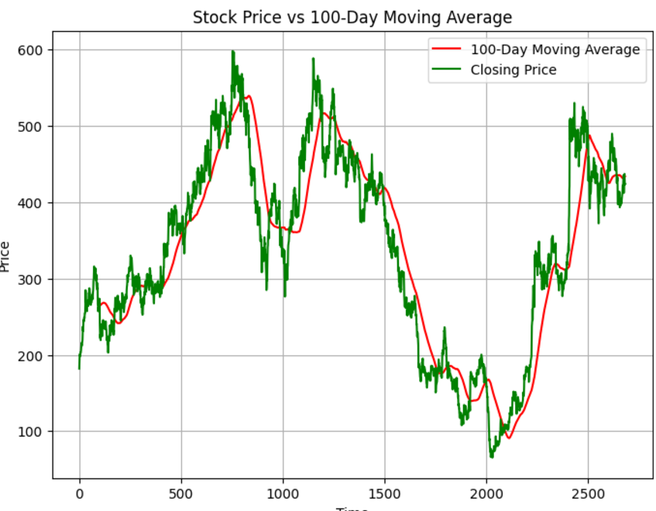
Results

Slide 13
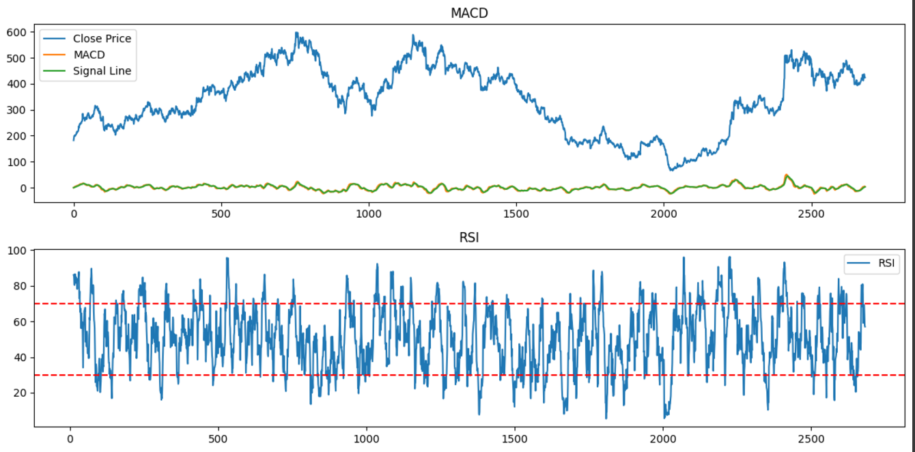
Results

Slide 14
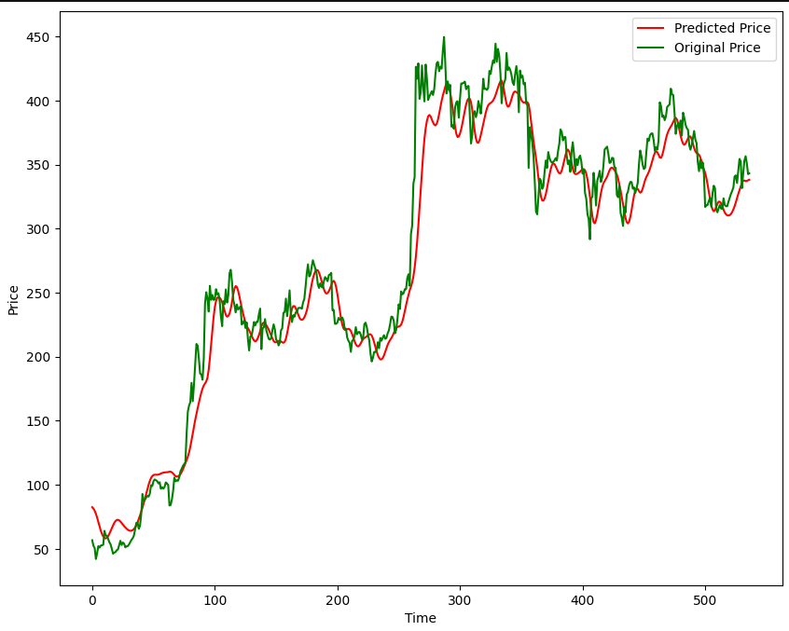
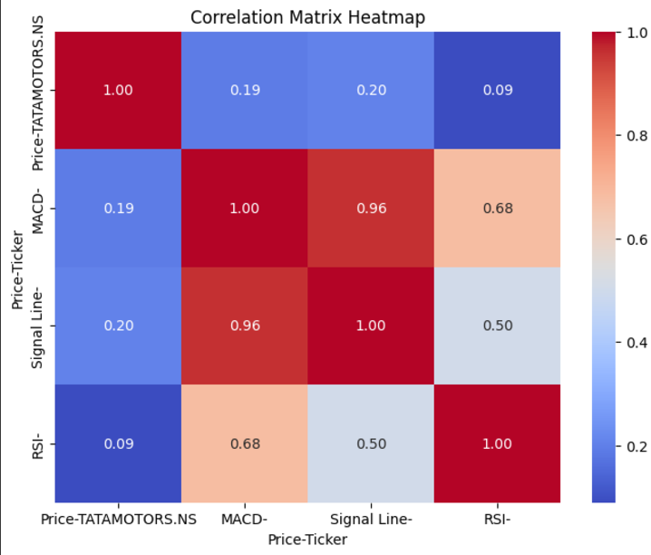
Results

Slide 15
Conclusion
Effective Prediction with LSTM: The Long Short-Term Memory (LSTM) network successfully predicts stock prices by learning the temporal dependencies in historical data, offering a powerful tool for time-series forecasting.
Accurate Results: The model demonstrates high accuracy with evaluation metrics such as low Mean Squared Error (MSE) and high R², making it a reliable method for stock price prediction.
Future Enhancements: The model can be further improved by incorporating more advanced techniques like hybrid models, feature engineering, or external factors (news sentiment) for better prediction accuracy.

Slide 16
References
Zhang, Y., Zhang, L., & Li, Y., "Comparing LSTM and traditional machine learning models for stock price prediction," Journal of Artificial Intelligence Research, Vol. 69, pp. 1-17, 2020.
Chaudhuri, S., Patra, S., & Saha, S., "Comparing ARIMA and LSTM models for time series forecasting," Proceedings of the 2021 International Conference on Computational Intelligence (ICCI), pp. 221-229, 2021.
Mochihashi, D., Takamatsu, S., & Nagata, M., "Stock price prediction using LSTM networks," Proceedings of the 2016 IEEE Conference on Neural Networks (IJCNN), pp. 3669-3674, 2016.
Fischer, T., & Krauss, C., "Deep learning with long short-term memory networks for financial market predictions," Proceedings of the 2018 IEEE International Conference on Data Mining (ICDM), pp. 1-10, 2018.

Slide 17
YouTube
https://youtu.be/P3JlMWoP3fE
https://youtu.be/1O_BenficgE
https://youtu.be/XVN3XlF-naA

Slide 18
THANK- YOU

